Slide 1
VU Meter Lab
Marc Lichtman

Slide 2
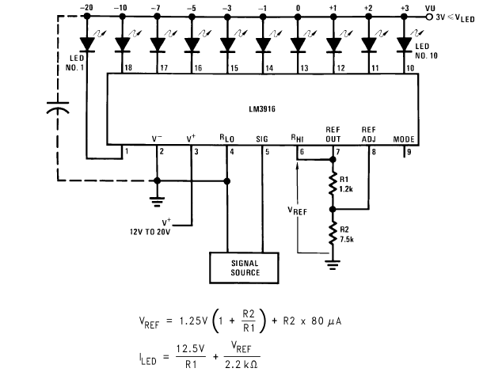

Slide 3

Calculations
R1 = 2k ohm (red black red)
R2 = 200 ohm (red black brown)

Slide 4
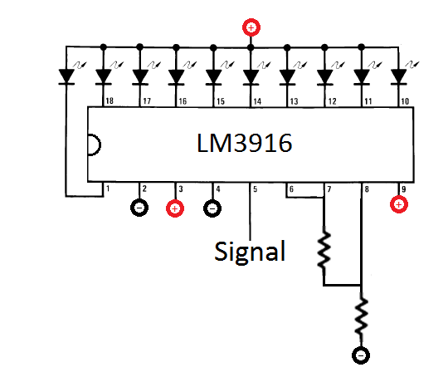
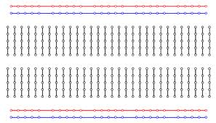
LM3916
10 LEDs
9 volt battery
2k ohm resistor (red black red)
200 ohm resistor (red black brown)
200 ohm
(red black brown)
2k ohm
(red black red)
Notes
  For LEDs, longer pin is the + side
  Make sure the notch on the chip is at the top

Slide 5
How to make this yourself
Go to an online retailer like jameco.com or digikey.com
Find an LM3916, 10 low cost LEDs, and resistors
Search “stripboard” to find a board to solder everything to like this one
Learn how to solder
Use either my schematic or the LM3916 datasheet to design the circuit
Find an old pair of headphones and cut off the connector, then find a headphone splitter so you can connect both the circuit and a pair of speakers to the source of music

